Slide 1
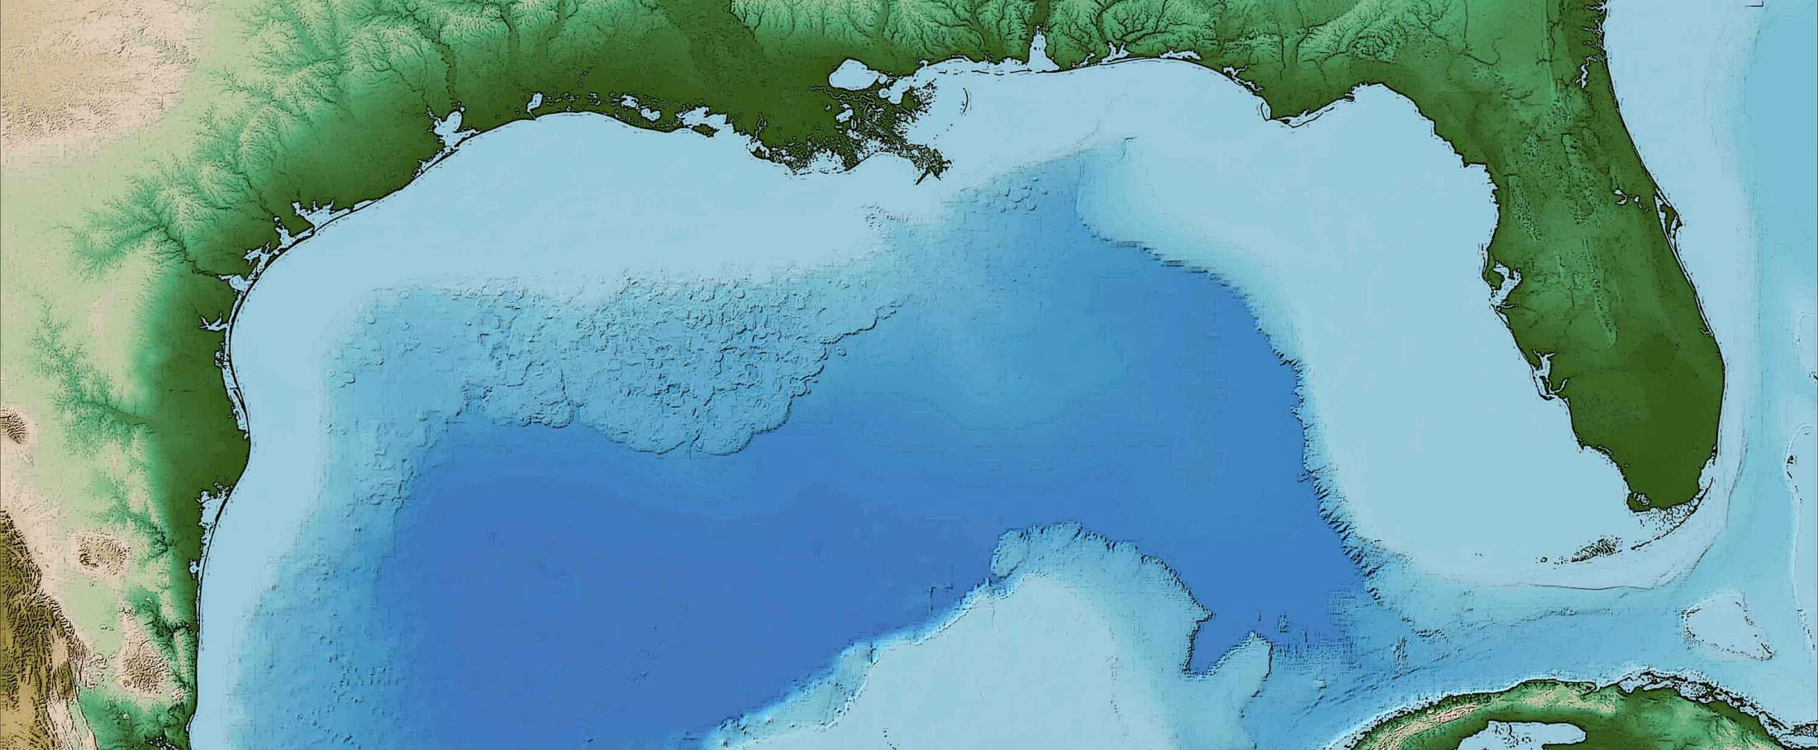
Applications Submission Process Check-in
August 25, 2016
Notes:
Purpose is to:
Review resources available to you in developing your applications and submitting them into RAAMS
Provide some further guidance, based upon our reviews of early submissions
Note: This webinar is not a comprehensive tutorial. Rather, we are seeking to share common themes and issues we are seeing thus far.

Slide 2
Agenda
RAAMS Stats
Application Development & Submission Support
RAAMS Reviews Process & Workflow
Programs Reviews Topics
Grants/Budget Reviews Topics
Continued dialogue with Applicants

Slide 3
RAAMS Statistics
Statistics:
22 Applications in Progress
19 Applications Submitted
8 Applications in Review
8 Applications in Revision
3 Awards
105 Applicant Users
22 Staff Users and External Reviewers
Notes:
As of August 25, 2015

Slide 4
Application Development & Submission
Applicant Support:
RAAMS Help Desk
(504) 444-2540
raams_techsupport@restorethegulf.gov
Staff: Zachary Konkol, Fernando Buchler
Council Staff
Grants Team: Kristin Smith, Josh Easton, Bridget Zachary
Program Team: John Ettinger, Alyssa Dausman, Heather Young, Jessica Henkel, Jean Cowan, Michelle Fischer, Craig Conzelmann
Notes:
Any questions can be directed to the RAAMS Help Desk. Please call the Help Desk for all technical questions related to RAAMS or developing and submitting your applications. The Help Desk staff can also put you in touch with the appropriate Council staff member if you have programmatic or grant-related questions.

Slide 5
Application Development & Submission
Applicant Support:
www.restorethegulf.gov/gcerc-grants-office/gcerc-grants-resources
Recipient Proposal and Award Guide
RAAMS User Guide
Templates
Project Information
Budget Information
Others
www.restorethegulf.gov/gcerc-grants-office/council-grants-training
Notes:
Various resources and tools to assist you in developing and submitting your application in RAAMS are available on the Grants Resources web page.
Training materials and webinar recordings are available on the Grants Training page.

Slide 6
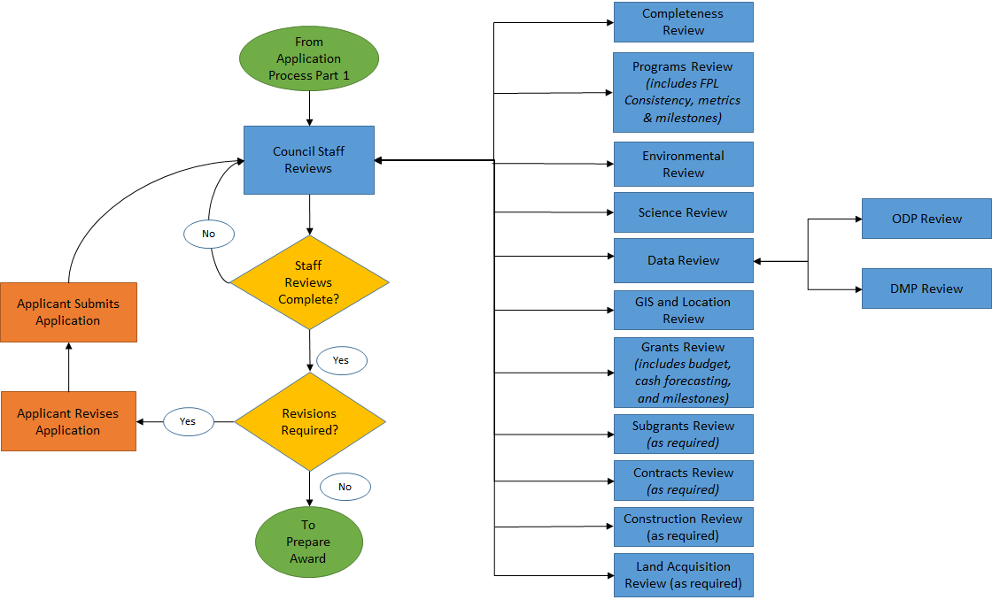
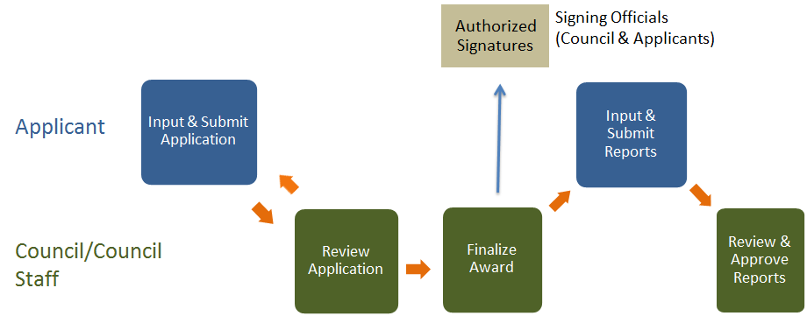
RAAMS Reviews Process & Work Flow
Notes:
This is the basic workflow for the application, review and reporting process.

Slide 7
Programs Reviews Topics
Funded Priorities List (FPL) Consistency:
Ensure the activity in the application is consistent with the Council-approved description in the FPL (i.e. title, cost, scope, goals & objectives, etc.)
If an activity in application differs from FPL appendix, sponsor may need to present the change to Steering Committee for review
Link to FPL and original proposals: https://www.restorethegulf.gov/council-selected-restoration-component/funded-priorities-list
Aug. 2014; Proposal submission guidelines released
Nov. 2014; 50 Proposals submitted
Spring 2015;
380 Components Identified
December 2015;
45 Category 1 components approved for funding on FPL
Application for funding via RAAMS (NOW!)
Notes:
The first thing we look at in the Programs review is whether the application is consistent with the FPL with respect to the title, total cost, general scope, program goals & objectives (the latter from the original proposals they submitted)
The FPL supersedes all other documents, but the goals & objectives come from the goals and objectives from Project Proposals
Note: If a project as described in the application is inconsistent with the way it was were described in the FPL and previously approved by Council members, it may become necessary for the sponsor to present a modification to the Council members for approval (depending on the nature and scope of the changes)

Slide 8
Programs Reviews Topics
Level of Detail:
Along with the budget narrative, the project narrative will become part of the grant/IAA award documentation.
The level of detail in the application must be sufficient to provide the reviewer with a full understanding of what is being funded.
A template for the project narrative portion of the application, including milestones, has been placed on the grants webpage.
https://www.restorethegulf.gov/gcerc-grants-office/gcerc-grants-resources
Notes:
What Council Staff look for in our review of applications:
Program staff conduct a detailed review for clarity and completeness of information provided in the narratives -- mostly project narrative, but we also rely somewhat on the budget narrative (e.g., types of expertise that will be employed to do the work -- more on that from Grants Staff).
The application needs to be clear not only to Council Staff, but also for others that review in the future. If an award were to be audited it is important to have this level of clarity in the narratives.
Risk is another big area we have to review, to ensure that operational, ecological, Environmental Compliance risks are reasonably identified and mitigations (if needed) are described.
If you are doing a type of project for the first time, and you don’t know what the risks are, please reach out and we can either provide guidance to you or help you connect with others who can help you think about this as part of building a community of practice.
We also look at milestones from perspective of reasonableness of types of milestones for the work to be conducted, as well as duration and cost for each activity.
In filling out the milestones section of the project narrative, also open the milestones template, as that provides more detail.
Think about milestones as you would about building a project management GANNT chart. What are the major groupings of tasks, and sequencing of tasks, that must be accomplished to complete your project? What duration and cost for each of those tasks seems reasonable based upon what you know right now?
These can and will change over time, so just make your best estimate right now.
Milestones needs to be related to/consistent with the budget summary and the cash flow projections that will be discussed momentarily.

Slide 9
Environmental Compliance (EC)
Checklist is available online:
https://www.restorethegulf.gov/gcerc-grants-office/gcerc-grants-resources
EC Checklist pertains to activity approved in FPL
“Yes” = law applies to activity, has been addressed
If “Yes” is checked, documentation is required
“No” = law applies to activity, has not yet been addressed
“N/A” = law is not applicable to given activity
Notes:
Compliance with most laws was determined prior to being selected for the FPL.
Compliance with the remainder of the laws must be demonstrated:
1) prior to either a grant or IAA being awarded, or
2) prior to full disbursement of implementation funds

Slide 10
Environmental Compliance cont.
Planning-Only Activities:
Check “Yes”for NEPA, add link to Categorical Exclusion
https://www.restorethegulf.gov/funded-priorities-list
Check “N/A” for other laws (with potential exceptions)
e.g., if CWA Section 404 permit needed for geotech work
Implementation Activities:
Council addressed NEPA, ESA, MS-A, NHPA and FWCA - as applicable
Reference Council EC document for the activity (link above)
Case-by-case for all other laws - applicant’s responsibility

Slide 11
Environmental Compliance cont.
Awardees:
Responsible for:
Carrying out environmental conditions associated with NEPA, ESA and other laws - where applicable
Compliance with all applicable environmental requirements that were not addressed at FPL stage
Must provide Council with EC documentation for applicable laws
Special Award Condition(s):
The Council may require certain activities to ensure compliance with applicable laws
remain responsible for all applicable federal and state environmental requirements
Notes:
After receiving a project application, the Council may impose Special Award Conditions related to specific environmental laws.
Council has addressed NEPA, ESA, MS-A, NHPA and FWCA at FPL stage, as applicable. Members/awardees are responsible for (1) carrying out any actions needed to ensure compliance with those laws (e.g., project design criteria for ESA or MSA) and addressing any applicable laws that have not yet been addressed (e.g., CWA 404 in some cases).

Slide 12
Programs Reviews Topics
Observational Data Plans (ODP) and Data Management Plans (DMP):
Intended to be stand alone documents.
Budgets listed on ODP/DMPs should include a description of where in the Overall Project budget those costs are found.
Metrics in the ODP must match the metrics selected in RAAMS.
ODPs and DMPs are iterative documents that can be updated.
Guidance documents on the grants resources page include:
Templates with examples.
ODP and DMP review checklists used to review your plans.
FAQ document for ODP/DMP preparation.

Slide 13
Programs Reviews Topics
Data Management Plans (DMP):
In-house data management / metadata capabilities
Storage vs. Archival: The DMP needs to address whether the data will be archived (different from backing-up), or indicate archiving is not available.
Exposure: The DMP needs to address how the data will be shared with the Council and if it will be available to the public at large.
DOI: The DMP needs to address whether the applicant will acquire a Digital Object Identifier for the data.

Slide 14
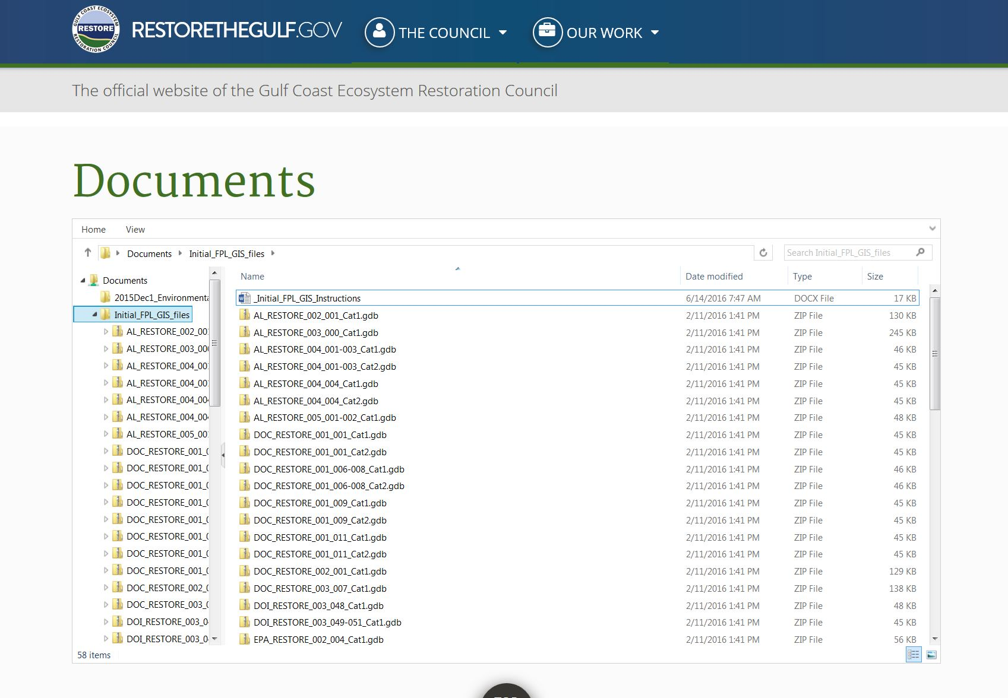
Programs Reviews Topics
GIS:
Use the GIS and Metadata templates available.
Ensure you update the appropriate fields/information and these match table in the appendix of the FPL.
GIS files exist for each project in the “Sandbox”
Contact Michelle Fischer if you need assistance accessing your project file (michelle.fischer@restorethegulf.gov)
Notes:
NOTE: All FPL projects should have GIS geometry in file geodatabase form available from the RESTORE Staff. We ask that you update the geometry and attribution IF necessary to represent any changes which may have occurred.

Slide 15
Grants/Budget Reviews Topics
Personnel (in RAAMS)
Identify key individuals
Agency Responsible Official (signatory)
Project Lead/Manager/PI
Financial Lead
System-specific roles and access
Primary Person
Public Project File Access
Permissions
Notes:
In addition to the staff involved in entering the application into RAAMs, the following 3
people, at at minimum, should be identified in RAAMS in the Personnel section. In addition
to being points of contact for the Council staff, these people may be listed in the grant or IAA.
Agency Responsible Official ‐ person who will sign the grant or IAA
Project Lead/Manager/PI ‐ lead person responsible for carrying out project; may be different from Primary individual responsible for submitting the application in RAAMS.
Financial Lead ‐ the person we should call if we have a question about the budget or other
financial matters.
Users who are given Public Project File Access will have the following abilities:
*Ability to view all uploaded documents and completed tasks in the Award file.
*Ability to create at-will tasks such as amendment requests and payment requests.
*Ability to create and view PDFs of tasks in progress.
Managers should carefully consider who needs this type of access.
Please see the RAAMS Users’ Guide (available on the Grants Resources web page) for additional information related to specific user roles, access, and permissions.

Slide 16
Grants/Budget Reviews Topics
Organizations (in RAAMS)
Identify all organizations taking part in project
Partners
Co-funders
Subrecipients (if known)
Contractors (if known)
Search for organization before adding as new
If adding a new organization, include name, address and, if a subrecipient or contractor, DUNS
Notes:
Please use the Organization section in RAAMS to identify all organizations taking part in the project (including any subrecipients or contractors that are known when the application is submitted). To date, this has been missing across the board in the applications we’ve received.
In many cases, the organizations will not be in RAAMS yet, so will have to be added. To avoid duplicate entries of organizations, please search for the organization before adding a new one. Also, please note that you cannot edit this information once it has been submitted. Please make sure you have the organization name, address, and DUNS number available to enter into RAAMS.

Slide 17
Grants/Budget Reviews Topics
Budgets
RAAMS “Main” Budget
RAAMS Co-funding Budget
Subrecipient Budget (upload)
ALL COSTS:
Eligible?
Allowable?
Allocable?
Reasonable?
Necessary?
Budget narrative(s)
Provide for each type of budget (see above)
Supports budget
Very detailed cost information
Notes:
There are two types of budgetary information that must be submitted.
The first is the budget - the NUMBERS.
Budget data is entered directly into RAAMS for the primary organization’s expenses and any co-funding.
If there will be subrecipients, a detailed budget is required for each subrecipient once this information is known. If the subrecipient is not known, then provide an anticipated scope of work and estimated total amount. The subrecipient budget is prepared as a separate document and uploaded to RAAMS. There is a subrecipient budget template available on the Grants Office webpage.
The second is - the DETAILS.
For each budget, a budget narrative is needed that provides the details that support the budget.
For example, if you told us that $100,000 is needed to pay the project manager over 2 years, the budget narrative is where you show us how you got to that number.
The budget narrative provides the information that the grant specialist needs to know in order to determine that the costs are eligible, allowable, allocable, reasonable, and necessary to carry out the project.
The budget narrative template is broken down by object class (personnel, supplies, etc.) just like the budgets in RAAMS. You can decide how best to use the template to fit your project and situation.

Slide 18
“Unknowns” & Special Award Conditions
Common “Unknowns” at the Application Stage:
Subrecipient(s)
Contractor(s)
Exact Project Location(s)
Lands for Acquisition
Etc., etc., etc.
Provide as much information as you do know (e.g., processes for selection, scopes of work, etc)
Describe what information will be available post-award and when
Award likely to contain Special Award Conditions
Notes:
As mentioned previously, there may be a number of important pieces of information that you may not have when you submit the application.
In those cases, please provide as much information as you do know.
For example, you may know:
the scopes of work (SOW) for contractors and/or subrecipients, even if these are not yet known, how the contractor/subrecipient will be selected (procurement methods), and an estimate of what that SOW is expected to cost.
for land acquisition projects, the process that will be used to select parcels of land for acquisition and approximate acreage, but you may not know the exact tracts
It is also helpful to describe what information will be collected post-award to answer any remaining questions and when it will be available.
If you have this type of unknown info at the application stage, it is likely that the award will include Special Award Conditions - or SACs - to address each one.
For example…
the SAC may require you to provide specific information to the Council when the subrecipient is selected or before the land can be acquired. In some cases, funds will not be released until after all the conditions of the SAC have been met.

Slide 19
Additional Budget Notes
Application budgets are estimates
Budgets and budget narratives for different projects may require different information
Budget Narrative Template
https://www.restorethegulf.gov/gcerc-grants-office/gcerc-grants-resources
Other Helpful Resources - Grants Office Resources webpage
Subrecipient Budget Template
Land Acquisition Documentation
Planning | Primarily Personnel Costs / Contractual Costs
Construction | Construction Cost Categories /Often Contractual Costs
Land Acquisition | Acquisition and Associated Due Diligence and Legal Costs
Recipient Guidance
Notes:
We understand that application budgets are estimates. You are not tied to the exact figures in each cost category for the life of the project. Federal and Council regulations allow some movement of funds between cost categories without an amendment to the award. If necessary, we will work with you to do an amendment to adjust the budget.
Budgets and narratives for different types of project may look different, often use different cost categories, and usually require different information. Some examples are provided.
The Budget Narrative Template provides a good general overview of the information and level of detail needed when preparing the budget. In some situations, you may need to refer to additional tools and resources, such as the subrecipient budget template referenced earlier or the draft land acquisition documentation that is being developed. If you are doing construction or land acquisition projects, please refer to the sections at the end of the Recipient Guidance that covers these topics and special requirements associated with these types of projects.

Slide 20
Milestones and Cash Drawdown Budgets
Requested Amount = Total GCERC Costs =
(Project Info) (Budget)
Milestone Totals = Cash Drawdown Totals
(Milestones) (Cash Drawdown)
Timelines for the milestones and cash drawdowns should also correlate.
Notes:
The Requested Amount from the Project Information in RAAMS must equal the “Total GCERC Costs” (not including Co-Funding) in the RAAMS Budget, which must also equal the totals of the Milestone amounts, and the total of amount forecast for Cash Drawdown over the life of the award.
There should also be a correlation between the milestones and the cash drawdowns that are projected.

Slide 21
RAAMS Help Desk
(504) 444-2540
raams_techsupport@restorethegulf.gov

